Slide 1
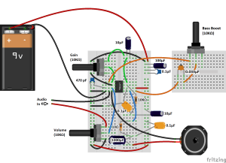
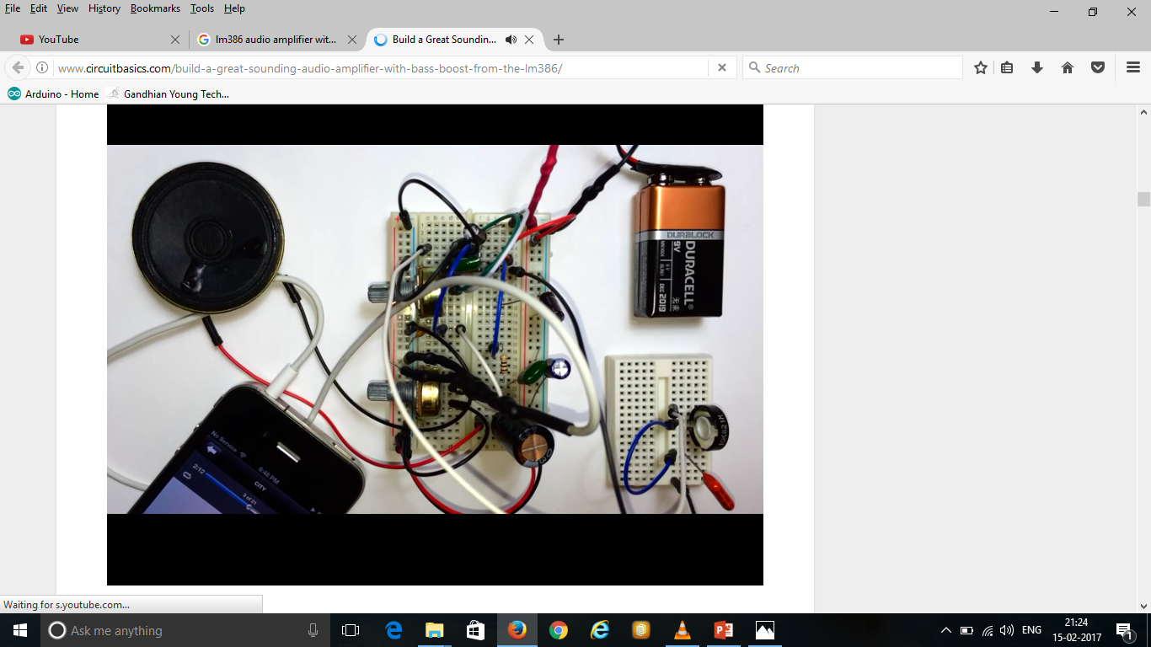
Bass Boost Audio Amplifier
Sarthak Sahni(16BEE1150)
VIT University Chennai

Slide 2
LM386 Basics
The LM386 is quite a versatile chip. Only a couple resistors and capacitors are needed to make a simple audio amplifier. The chip has functions for gain control and bass boost, and it can also be turned into an oscillator capable of outputting sine waves or square waves.
The LM386 is a type of operational amplifier (Op-Amp). Operational amplifiers have a basic task. They take an input potential (voltage) and produce an output potential that is tens, hundreds, or thousands of times the magnitude of the input potential. In this circuit, the LM386 takes an audio input signal and increases its potential anywhere from 20 to 200 times. That amplification is what is known as the voltage gain.

Slide 3
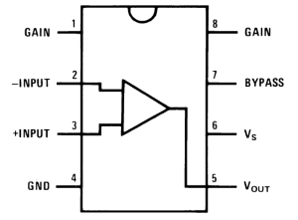
Gain vs Volume
After you build this amplifier and play with the volume and gain controls, you will notice that both appear to raise or lower the intensity of sound coming out of the speaker. So what is the difference then? Gain is the amplification of the input potential. It is a characteristic of the amplifier. Volume lets you adjust the sound level within the range of amplification set by the gain. Gain sets the range of possible volume levels. For example, if our gain is set to 20, the range of volume is 0 to 20. If our gain is set to 200, the range of volume is 0 to 200.
The LM386 IC has 8 pins as shown in the diagram below:

Slide 4
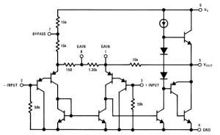
The main pins to be aware of are pins 2 and 3, the audio signal inputs, and pin 5, the positive audio output signal. Gain control can be achieved by bridging pins 1 and 8 with a 10 μF capacitor. If pins 1 and 8 are not connected, the output gain will be 20. With only a 10 μF capacitor, the gain will be 200. The gain can be adjusted to any value between 20 and 200 by placing a potentiometer in series with the capacitor.
There are three varieties of the LM386, each with different output power ratings:
LM386N-1: 0.325 Watts
LM386N-3: 0.700 Watts
LM386N-4: 1.00 Watts
Here’s a schematic of the internal circuitry of the LM386 for your reference:

Slide 5
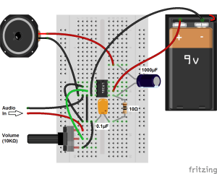
The Minimal LM386 Audio Amplifier
Now that we have a little background into the LM386, let’s build the amplifier. Just for comparison, I’ll show you how to make a minimal LM386 amplifier first, so you can compare it to the better sounding one we’ll build later on.

Slide 6
The Great Sounding LM386 Audio Amplifier
Now that you’ve seen the bare minimum of what it takes to make an audio amplifier from the LM386, lets build a higher fidelity version, and add an adjustable gain control. Several things in this circuit make it sound better:
A 470 pF decoupling capacitor between the positive input signal and ground.
100 μF and 0.1 μF capacitors between the positive and negative power rails to decouple the power supply. The 100 μF capacitor will filter low frequency noise while the 0.1 μF capacitor will filter high frequency noise.
A 0.1 μF capacitor between pins 4 and 6, for additional decoupling of the power supply to the chip.
A 10K Ohm resistor and a 10 μF capacitor in series between pin 7 and ground to decouple the audio input signal.

Slide 7
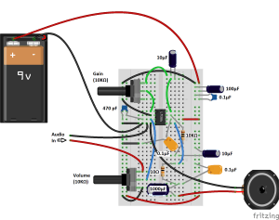
The diagram below will show you how to connect everything:

Slide 8
The LM386 Audio Amplifier with Bass Boost Control
A cool feature of the LM386 is the option to add an adjustable bass boost to the amplifier. You’ll find that this is the best sounding circuit so far, since the low pass filter removes most of the noise not taken out by the decoupling capacitors. All you need for the bass boost circuit is a 0.033 μF capacitor and a 10K Ohm potentiometer in series between pins 1 and 5:

Slide 9


